Slide 1
Classification results
November 2024
Andrea Corrado

Slide 2
Outline
Knowledge-based classifiers: previous results
Improved knowledge-based classifier
Machine learning approach: tree
Conclusions

Slide 3
Outline
Knowledge-based classifiers: previous results
Improved knowledge-based classifier
Machine learning approach: tree
Conclusions

Slide 4
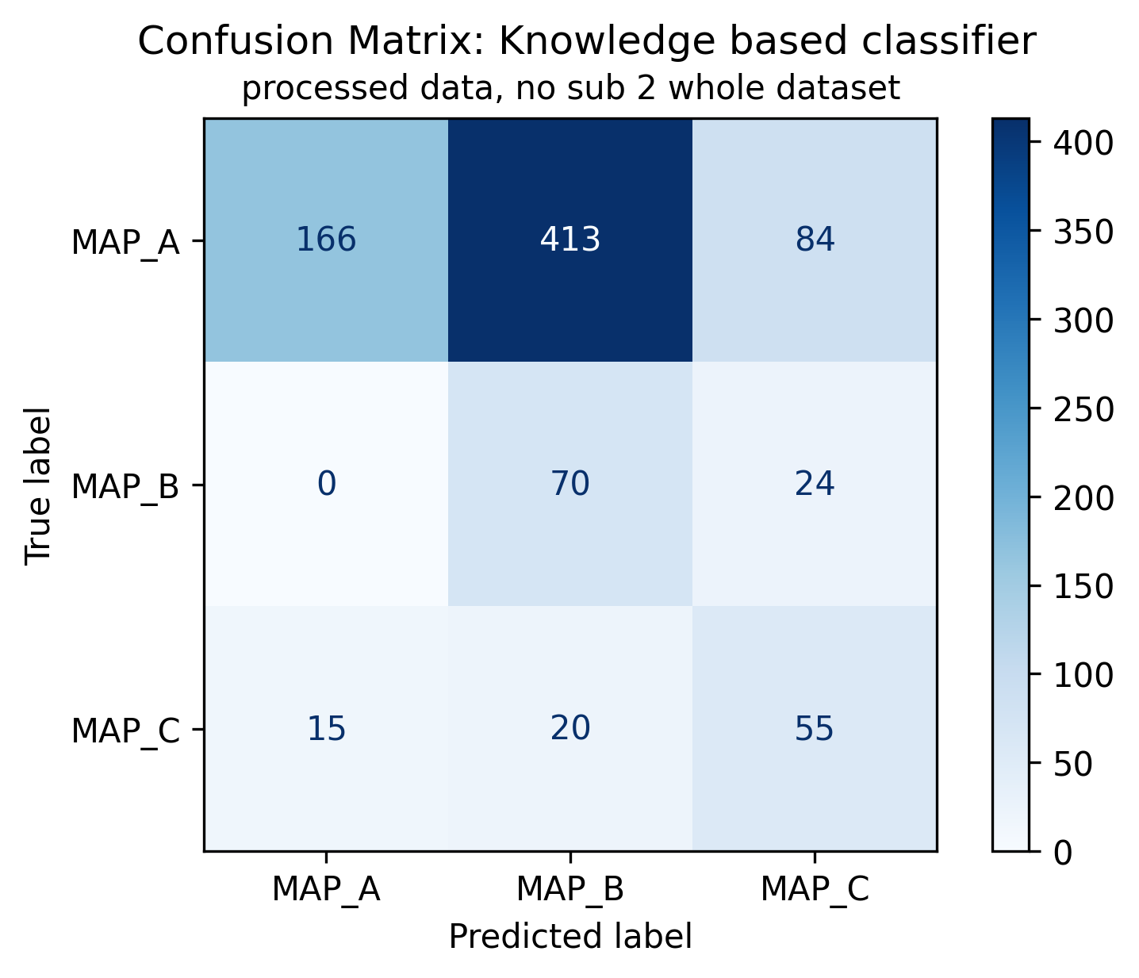
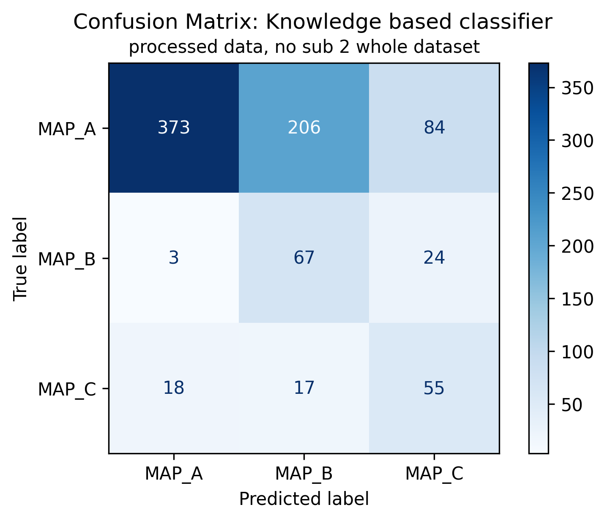
KB classifier V0 and V1: previous results
KB V1: atrial/ventricular ratio, th=0.5
KB V0: Atrial peak threshold
KB V1: atrial/ventricular ratio, th=0.5
Of 847 signals:
663 are ineffective (MAP A, 78.28%);
94 are effective (MAP B, 11.1%);
90 are dangerous (MAP C, 10.63%);

Slide 5
Outline
Knowledge-based classifiers: previous results
Improved knowledge-based classifier
Machine learning approach: tree
Conclusions

Slide 6
Knowledge based classifier with envelope-based features
For each roving trace, use the envelope to evaluate active areas. Then:
Improved KB V0: peaks thresholds and position
Improved KB V1: peaks thresholds and atrial/ventricular ratio
Is third peak >0.021?
No
Is peak_1_pos<0.49
No
Is third peak >0.021?
No
Is atrial_ventricular_ratio >0.09?
No
MAP B
MAP B
Yes
Yes
Yes
Yes
MAP C
MAP A
MAP C
MAP A

Slide 7
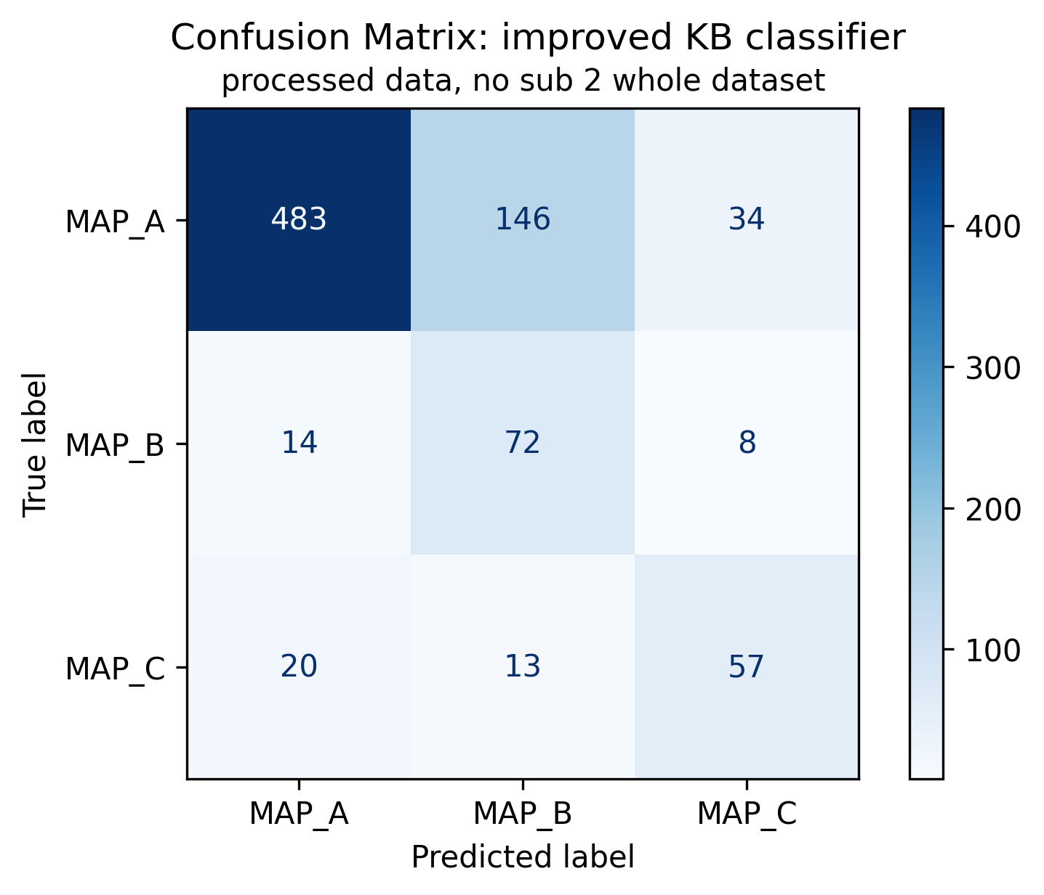
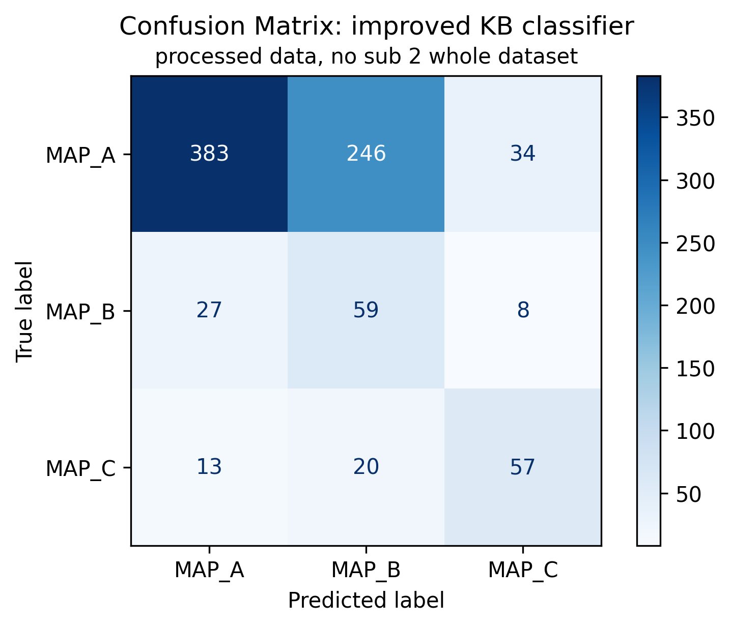
Knowledge based classifier with envelope-based features
Improved KB V0: peaks thresholds and position
Improved KB V0: peaks thresholds and position
Improved KB V1: peaks thresholds and atrial/ventricular ratio
Of 847 signals:
663 are ineffective (MAP A, 78.28%);
94 are effective (MAP B, 11.1%);
90 are dangerous (MAP C, 10.63%);

Slide 8
Outline
Knowledge-based classifiers: previous results
Improved knowledge-based classifier
Machine learning approach: tree
Conclusions

Slide 9
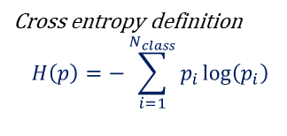
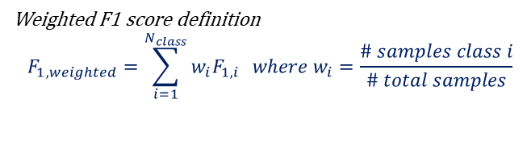
Machine learning approach: tree classifier
Machine learning approaches allow to model data with statistical models trained on a set of features.
Rules and relationships are not a priori fixed
Possible deeper feature relationship evaluation
Possibility of finding new insights on data
…
Tree models are among the most easily explained, therefore the choice felt on them.
Mathematical rules are defined into each node to minimize the impurity of the following level
An “impurity measure” is required
Tuning the depth of the three is required
LOPOCV is used as validation technique
Tree classifiers
Tree 1: whole feature set
Tree 2: relevant feature set
Impurity measure: Cross entropy
Impurity measure: Cross entropy
Depth: maximising weighted f1 score
Depth: maximising weighted f1 score
Cross entropy definition
$$H\left(p\right)=−\sum_{i=1}^{N_{class}}{p_{i}\log\left(p_{i}\right)}$$
Weighted F1 score definition
$$F_{1, weighted}=\sum_{i=1}^{N_{class}}{w_{i}F_{1,i} } where w_{i}=\frac{\# samples class i}{\# total samples}$$

Slide 10
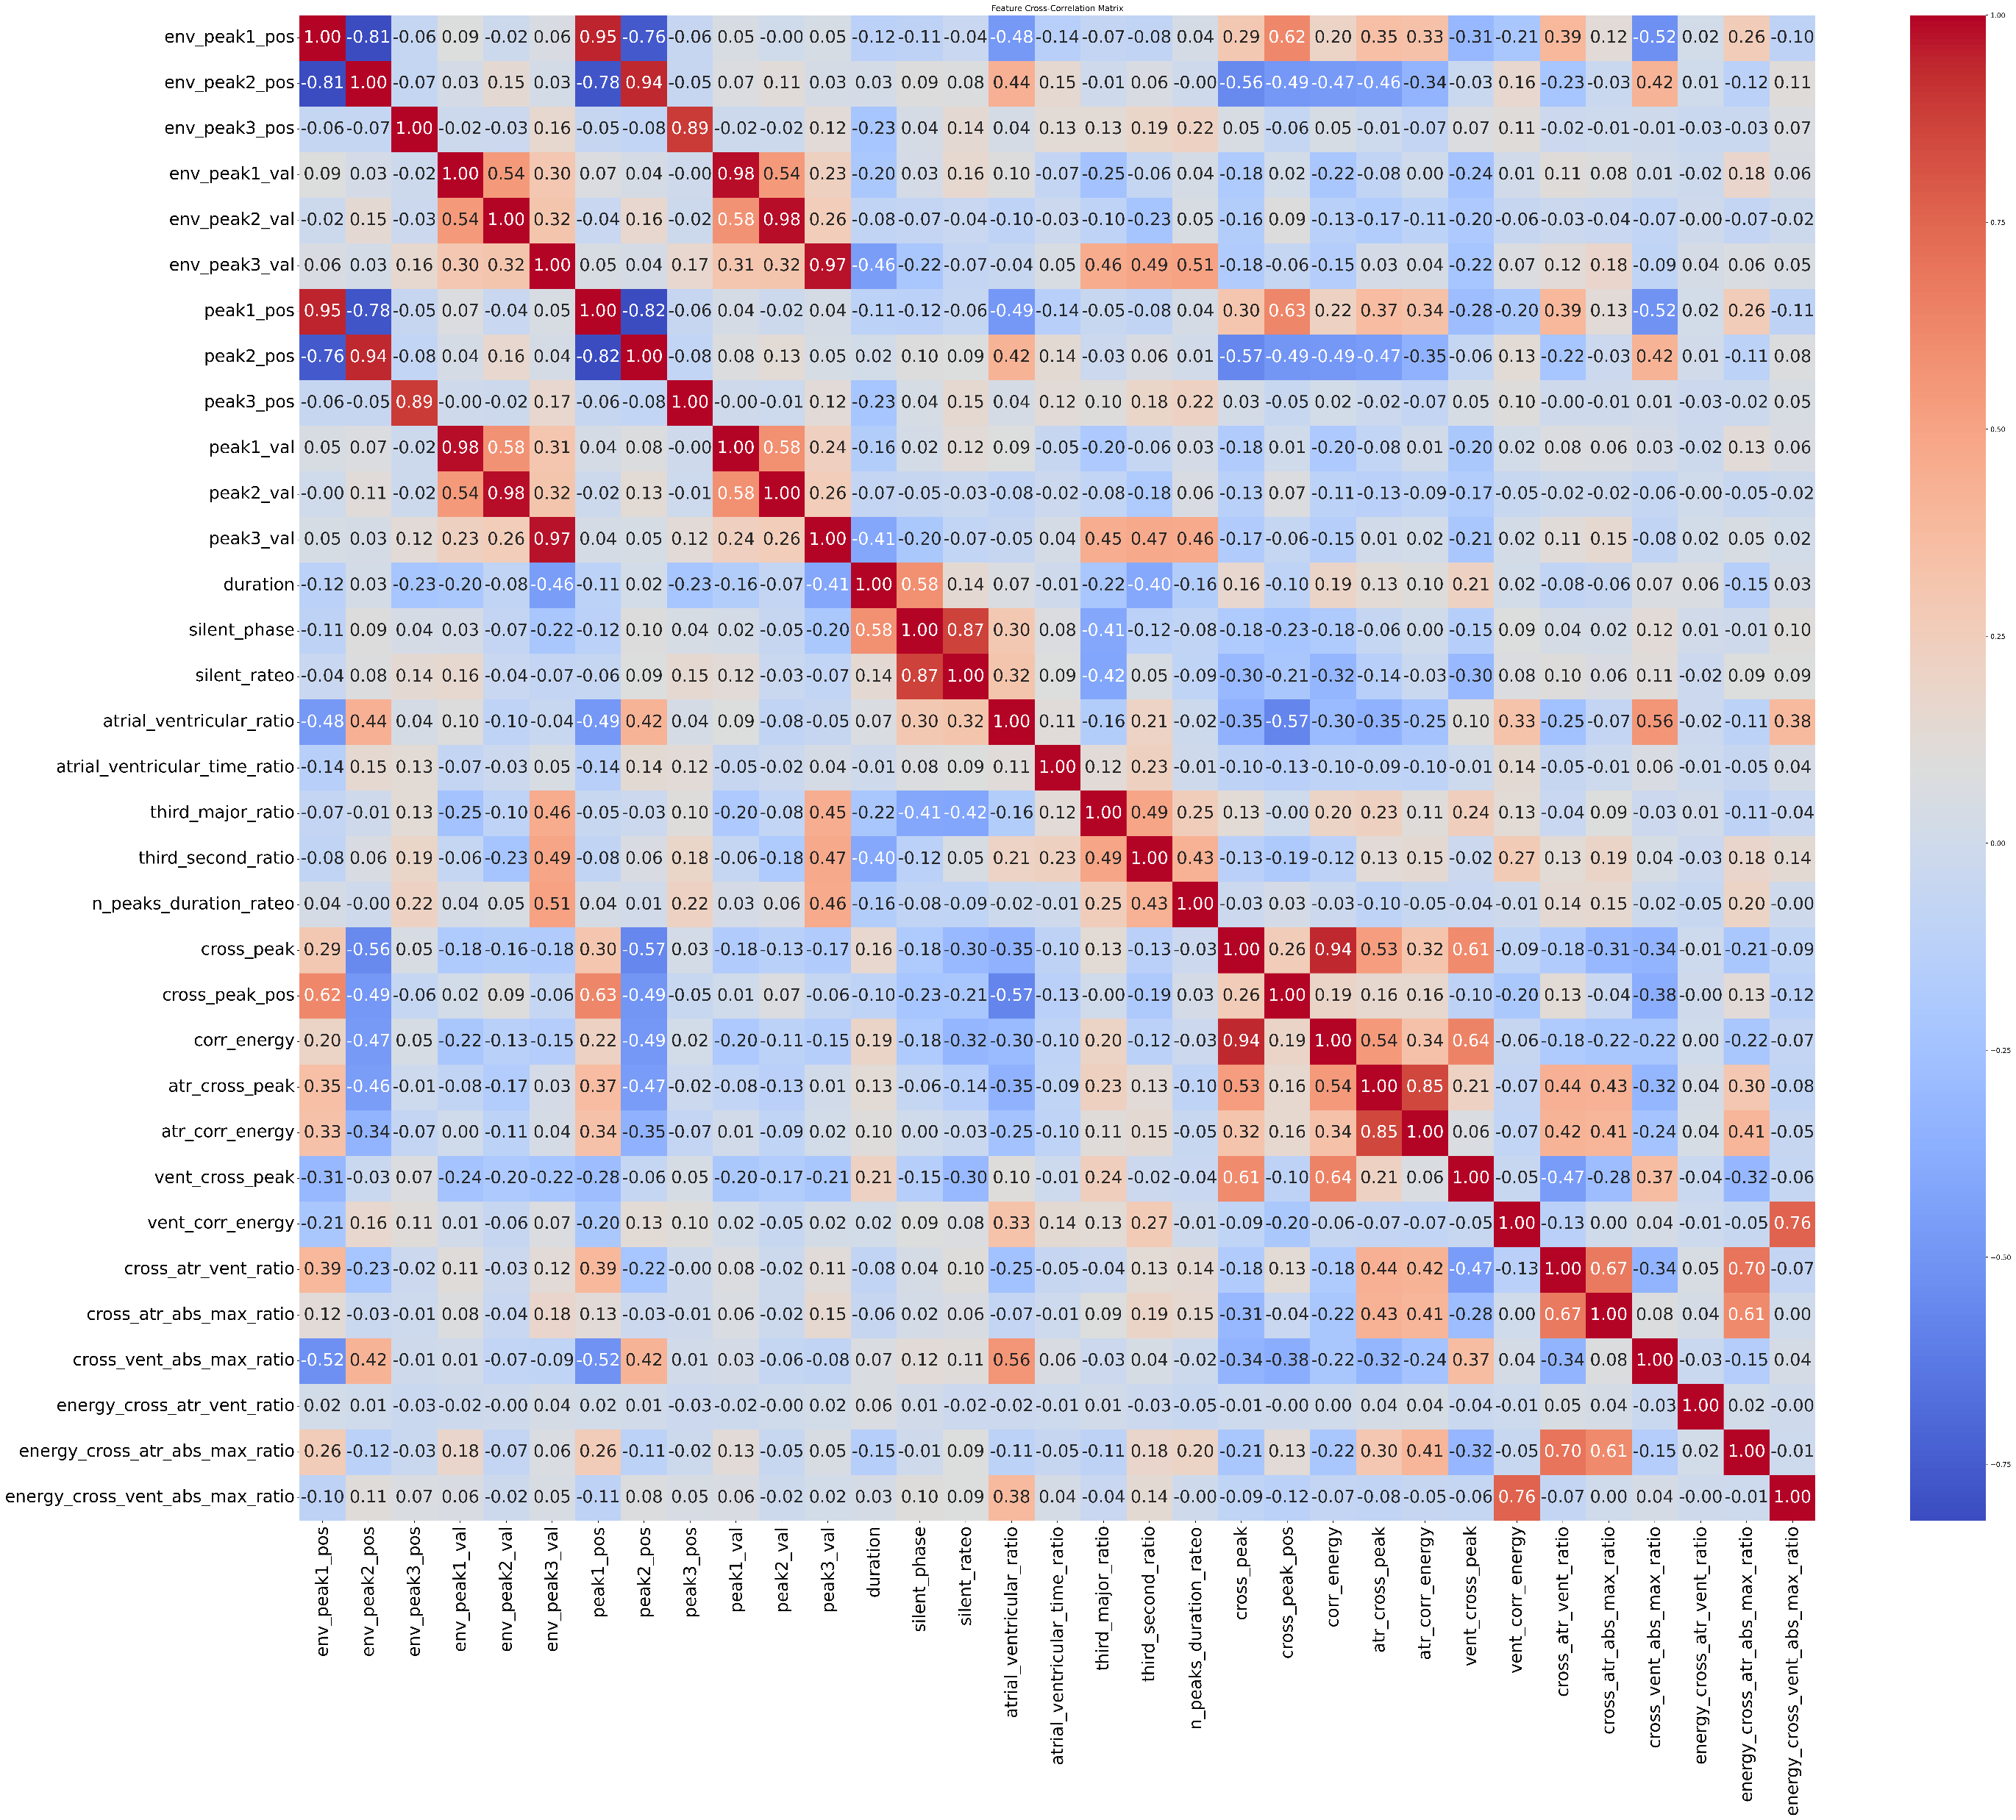


Feature selection: correlation matrix
To avoid the usage of features correlated between each other, correlation matrix has been computed.
A priori have been removed:
env_peak1_pos,env_peak2_pos,env_peak3_pos
env_peak1_val,env_peak2_val,env_peak3_val
silent_rateo,
cross_peak, cross_peak_pos, corr_energy, vent_corr_energy
energy_cross_atr_vent_ratio, energy_cross_atr_abs_max_ratio

Slide 11
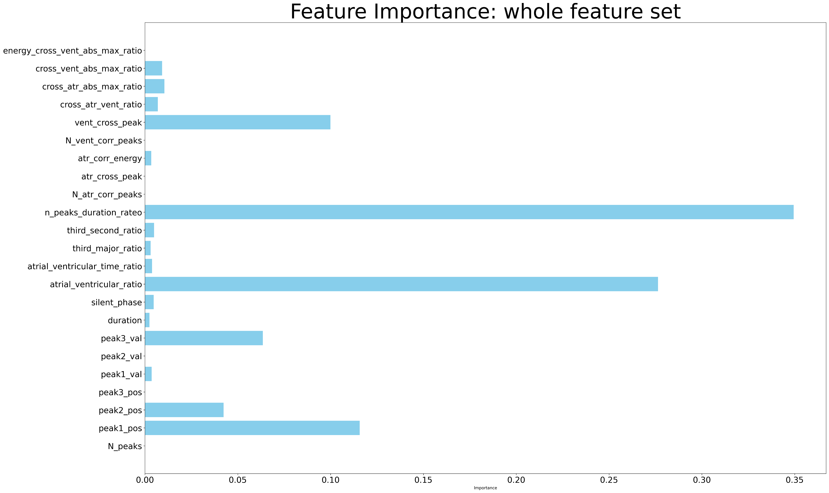
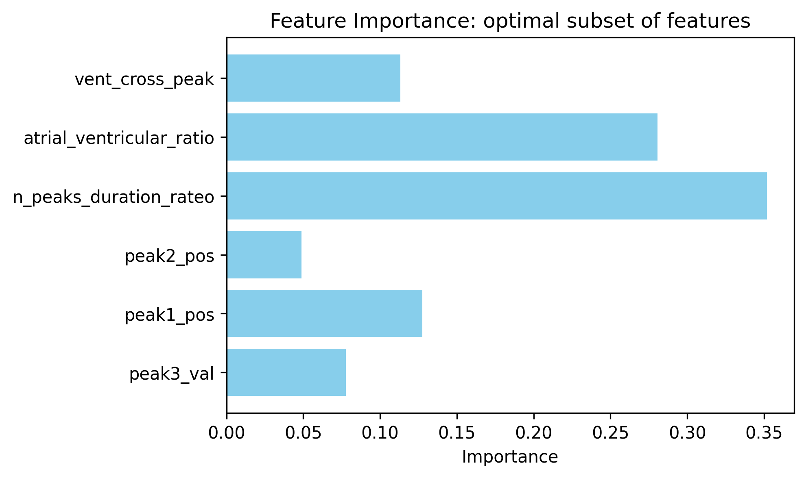
Feature selection: relative feature importance
The optimal subset of feature has been found using the training report of the models evaluated during LOPCV.
Tree 1: whole feature set
Tree 2: relevant feature subset

Slide 12
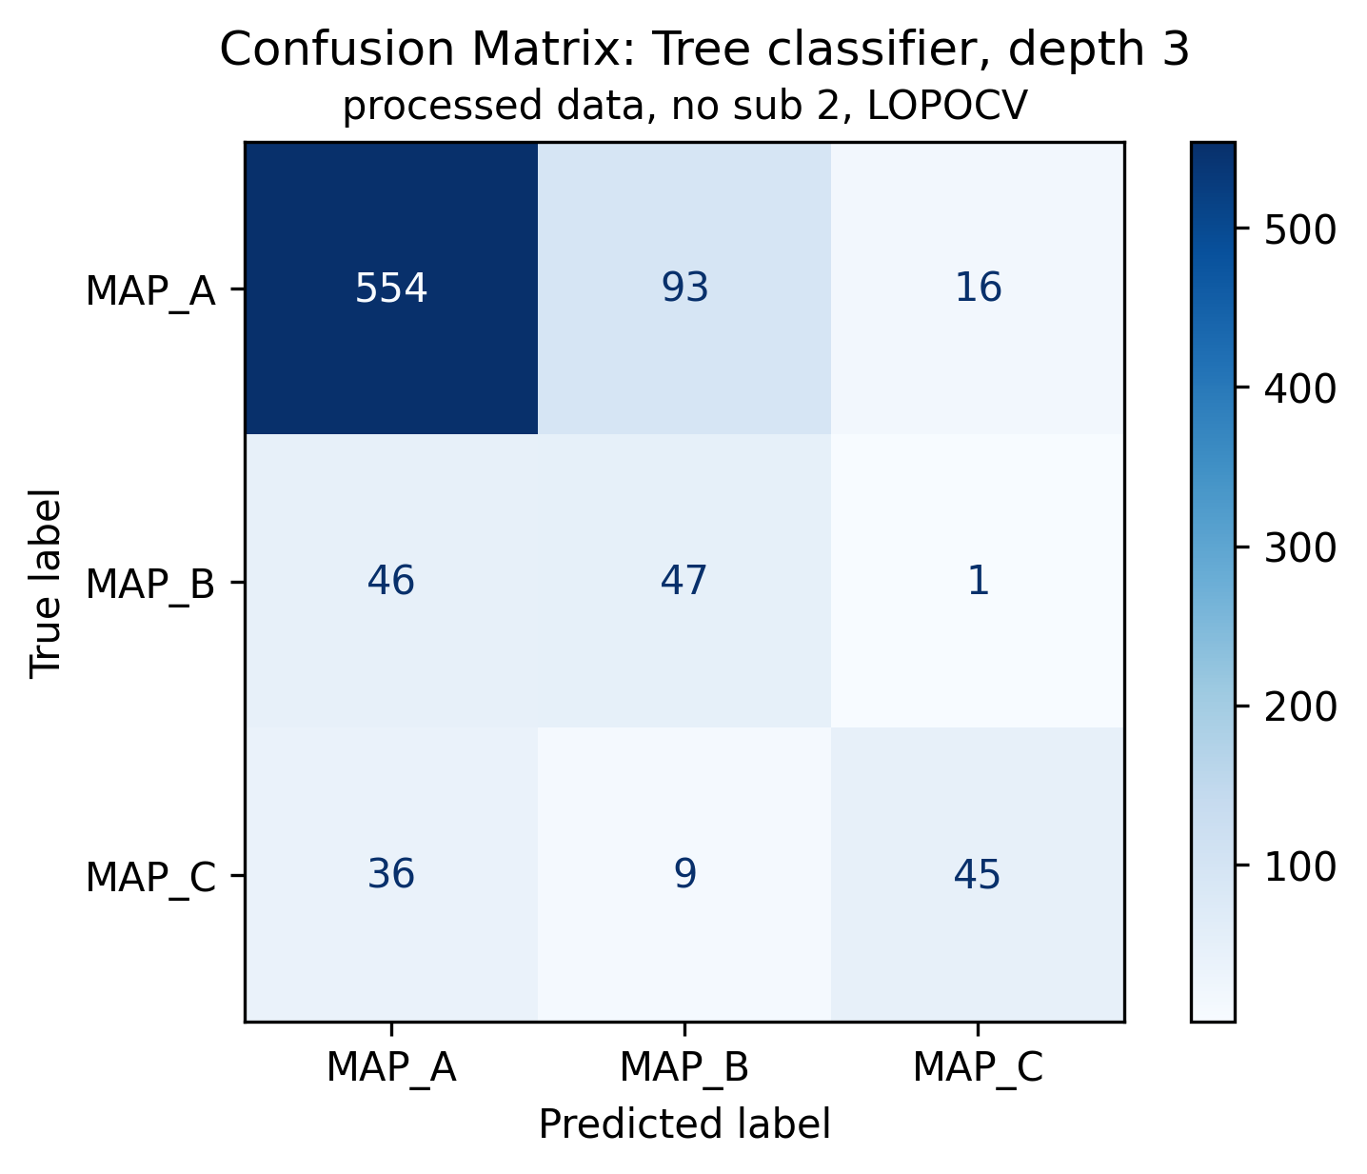
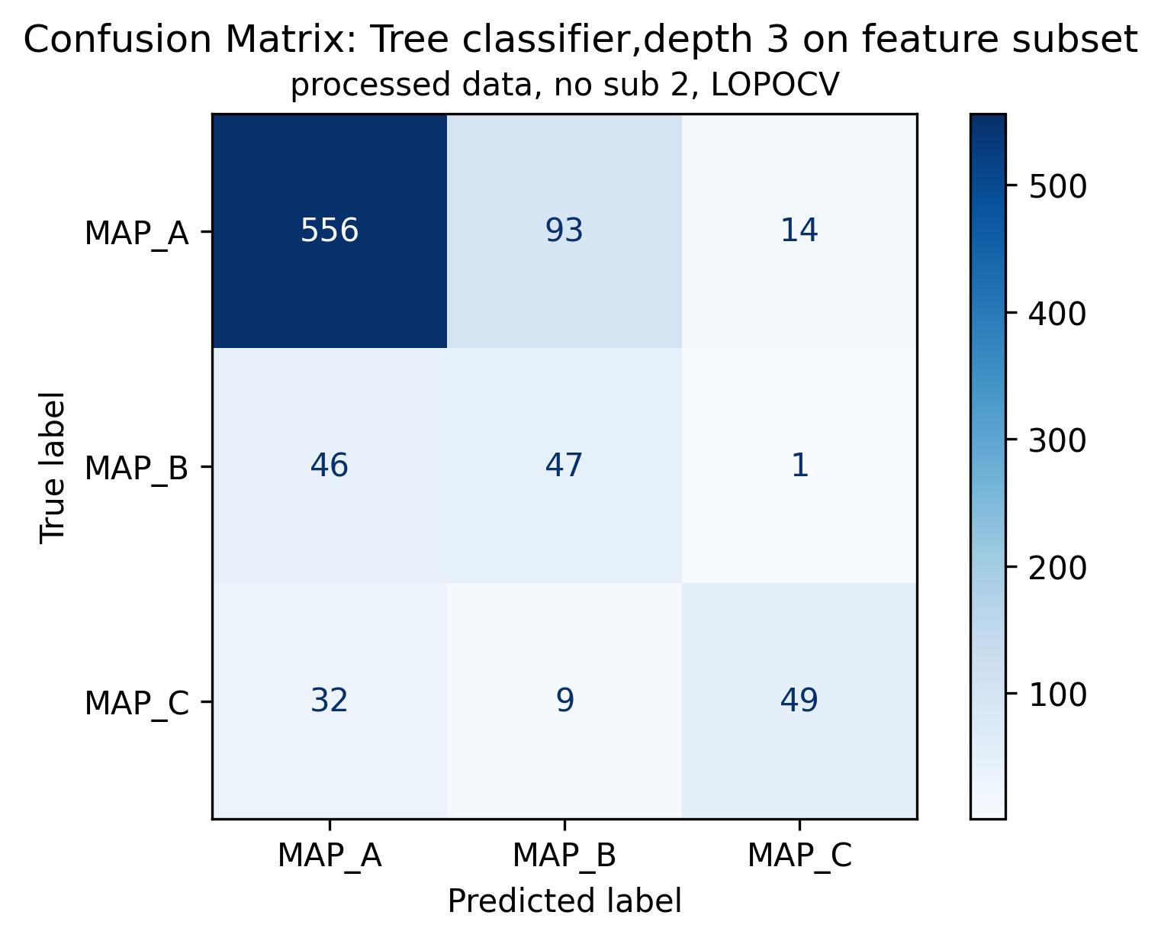
Tree classifier: LOPOCV confusion matrix
Tree 1: whole feature set
Tree 2: relevant feature subset
Of 847 signals:
663 are ineffective (MAP A, 78.28%);
94 are effective (MAP B, 11.1%);
90 are dangerous (MAP C, 10.63%);

Slide 13
Which is better?
Improved KB V0: peaks thresholds and position
Tree 2: relevant feature subset

Slide 14
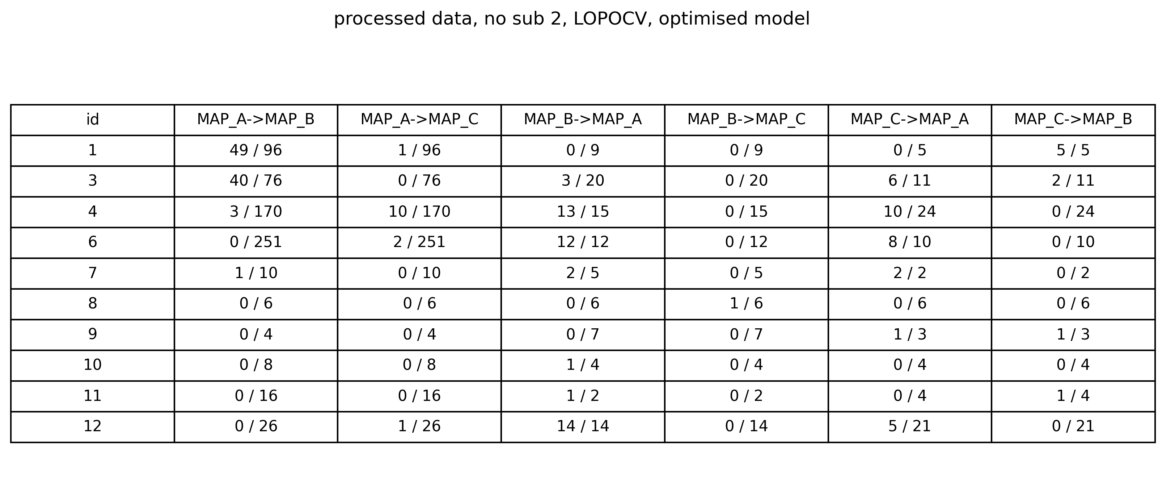
Is the model learning wrong?
What is learned here…
Has an impact here…
…and here

Slide 15
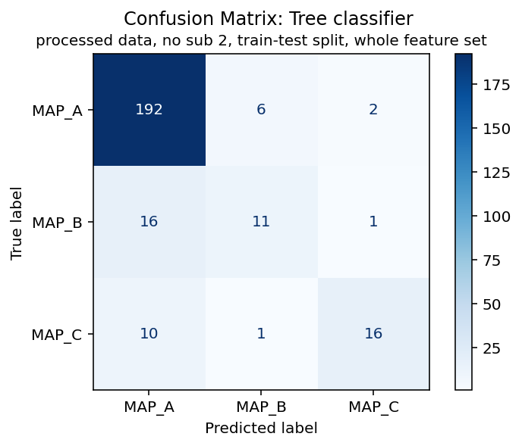
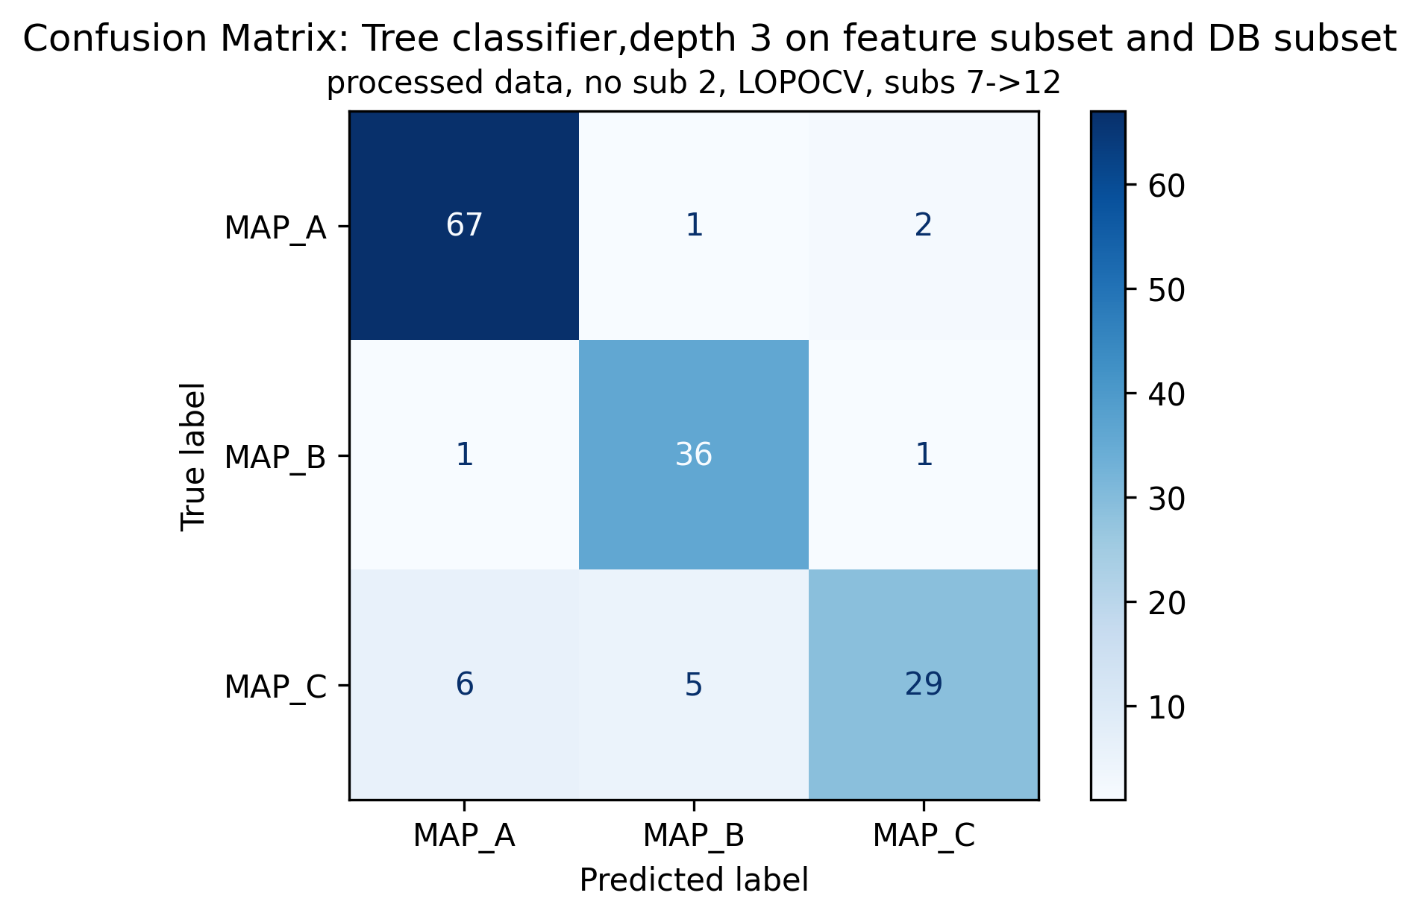
How to improve learning?
Tree on subs 7->12 and LOPOCV (relevant feature set)
Tree on 70-30% train/test split (relevant feature set)
Tree on subs 7->12 and LOPOCV (relevant feature set)
Of 255 signals:
200 are ineffective (MAP A);
28 are effective (MAP B);
27 are dangerous (MAP C);
Of 148 signals:
70 are ineffective (MAP A);
38 are effective (MAP B);
40 are dangerous (MAP C);

Slide 16
Outline
Knowledge-based classifiers: previous results
Improved knowledge-based classifier
Machine learning approach: tree
Conclusions

Slide 17
Conclusions
Two classification methodologies have been shown:
(Improved) Knowledge based classifier: best model uses thresholds on peaks positions and values
Tree classifier: best model uses a subset of features from both envelope and template matching
But performance are still unsatisfactory.
It has been shown that tree classifier can be “fooled” by the presence of signs of dubious classification:
Train/test split doesn’t improve generalization
Dropping misleading subjects improves performance
Future proposes:
Understanding the reasons why there are unexpected signals into MAP A
Unsupervised analysis of MAP A to find out if there are inner differences between features
Defining a new class (e.g., MAP_AB) which is a hybrid between MAP_A and MAP_B.

